Slide 1


R.M.K. COLLEGE OF ENGINEERING AND TECHNOLOGY DEPARTMENT OF ELECTRONICS AND COMMUNICATION ENGINEERING
B.E – PROJECT First Review- DATE: 23.01.2025
TITLE:
CLOUD BASED MCB TRIP MONITORING SYSTEM USING IOT
By
DHAARANI S 111621104030
NETHRA P 111621104104
NIVETHA R 111621104107
RANJITHA S 111621104126
SUPERVISOR
Dr.N.GANGATHARAN
HEAD OF DEPARTMENT - ECE

Slide 2
Contents
Objective
Introduction
Literature Review
Problem Statement
Proposed Work
Algorithm
Flow Diagram/Block Diagram
Mathematical Model

Slide 3
Contents
Simulation Tool/ Equipments/ Components
Conclusion
References
Work Plan

Slide 4
Objective
Enhance Residential Safety: The system monitors temperature, humidity, and circuit breaker status in real time, ensuring optimal operating conditions and mitigating risks of electrical hazards.
Enable Proactive Maintenance: By integrating with the Adafruit IoT platform, the system allows homeowners to track and manage electrical health remotely, receiving alerts and detailed logs for timely intervention and minimizing downtime.

Slide 5
Introduction
CLOUD BASED MCB TRIP MONITORING SYSTEM USING IOT
The Cloud-Based Domestic MCB (Miniature Circuit Breaker) Board Monitoring System is an innovative solution designed to enhance home safety by monitoring crucial electrical parameters in real time. By integrating advanced sensors to track temperature, humidity, and circuit breaker status, this system ensures optimal operating conditions for the electrical panel. The data is securely transmitted to the Adafruit IoT platform, providing homeowners with a user-friendly dashboard to monitor and manage the health of their home’s electrical infrastructure. This proactive approach minimizes risks, reduces downtime, and empowers homeowners to take timely action for maintenance and safety.

Slide 6
Literature Review
SI.No | Title of the Paper | Year of Publication | Methodology | Pros | Cons
1 | Design & Implementation on IOT Based Residual Current Circuit Breaker | October 2022 | Micro Controller Based System | Accurate | SCADA System
2 | The X, Y and Z of Circuit Breaker Control | March 2017 | Micro Controller Based System | Accurate | Slow
3 | Real-Time Circuit Breaker Health Diagnostics | October 2016 | Micro Controller Based System | Fast | Large data packet

Slide 7
Problem Statement
The increasing reliance on electrical systems in modern homes has heightened the risk of electrical hazards such as overheating, short circuits, and overloads. Traditional methods of monitoring electrical panels are reactive, often detecting issues only after they have caused damage. There is a need for a more proactive and accessible solution that enables homeowners to monitor critical parameters like temperature, humidity, and circuit breaker status in real time. Without such a system, homeowners are left vulnerable to potential safety risks and maintenance delays, which can lead to significant property damage or injury.

Slide 8
Proposed Work
The proposed solution is the Cloud-Based Domestic MCB Board Monitoring System, which integrates advanced sensors to monitor temperature, humidity, and circuit breaker status in real time. By leveraging IoT technology and cloud connectivity, this system provides homeowners with immediate access to critical data through a secure and user-friendly dashboard. This enables proactive monitoring, timely maintenance, and enhanced safety by alerting users to potential hazards before they escalate into serious issues. The system ensures data privacy and security through encryption, offering a reliable, innovative approach to home electrical safety.

Slide 9
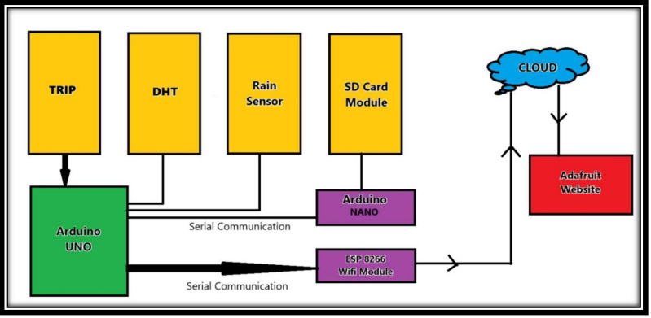
FLOW MATRIX

Slide 10
FLOW MATRIX
Data Collection: Sensors installed in the electrical panel continuously monitor key parameters such as temperature, humidity, and circuit breaker status.
Data Transmission: The collected data is transmitted wirelessly to a secure cloud platform (e.g., Adafruit IoT), ensuring real-time updates.
Data Storage and Processing: The IoT platform stores and processes the incoming data, enabling historical data analysis and identifying any trends or abnormalities.
User Interface: Homeowners can access the cloud platform’s user-friendly dashboard to view real-time data and historical trends, monitor their electrical system’s health, and review trip logs.
Alerts and Notifications: The system sends customizable notifications to homeowners regarding critical events such as circuit breaker trips or abnormal temperature/humidity readings, allowing for immediate action.

Slide 11
Simulation Tool/ Equipments/ Components
Arduino Uno Board: Used for trip monitoring and detecting circuit breaker trips.
Adafruit Website: Platform for displaying trip data and other monitoring details.
SD Card Module: Logs and stores trip data locally with timestamped records.
Temperature Sensors: Monitor temperature within the MCB board.
Water Sensors: Detect water presence inside the MCB board and send alerts.
ESP8266 Wi-Fi Module: Provides wireless communication for seamless data transmission.
Arduino Nano Board: Facilitates serial communication between components.

Slide 12
Conclusion
The Cloud-Based Domestic MCB Board Monitoring System offers a significant advancement in home electrical safety by enabling real-time monitoring of critical parameters. Through seamless integration with IoT technology and cloud connectivity, the system empowers homeowners to take proactive measures in maintaining their electrical systems, reducing the risks of electrical hazards, and ensuring optimal performance. By providing a user-friendly interface, detailed analytics, and timely notifications, the system enhances overall home safety while offering convenience and peace of mind. This innovative approach not only addresses the limitations of traditional monitoring methods but also sets a new standard for residential electrical management.

Slide 13
References
[1] R. Bangale, P. Gangane, R. Wankadhe, V. Mandwale, and S. B. Warkad, "Design and Implementation on IoT-Based Residual Current Circuit Breaker," P R Pote (Patil) College of Engineering and Management, Amravati, India.
[2] Brent L. Carper, Principal Engineer, “The X, Y and Z of Circuit Breaker
Control”, 34th Annual Hands-On Relay School, March 2017.
[3] Jason M. Byerly, Carey Schneider, Robert Schloss, Isaac West “Real-Time
Circuit Breaker Health Diagnostics,” 43rd Annual Western Protective Relay, Conference, October 2016.
.

Slide 14
Work Plan
Activity/Time Period | Dec | Jan (1-15) | Jan (16-31) | Feb (1-15) | Feb (10-27) | March (1-15) | March (16-31)
Literature Survey
Study of Simulation Tool for System design
Study of simulation Tool for Code Design
Simulation and Design of Code
Incorporation with Cloud
Preparation and Submission of the final report

Slide 15
Thank You

